Slide 1
Complex CMOS Logic Gates
INEL4207

Slide 2
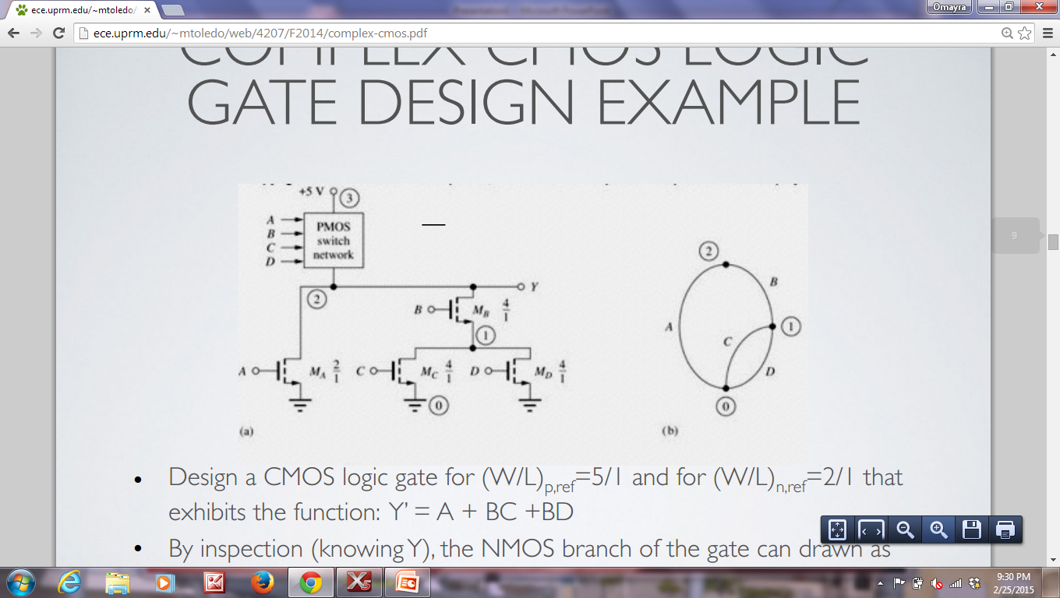
Complex Gate Example
Design a CMOS logic gate for (W/L)p,ref=5/1 and for (W/L)_{n,ref}=2/1 that exhibits the function: Y’ = A + BC +BD
By inspection (knowing Y), the NMOS branch of the gate can drawn as the following with the corresponding graph, while considering the longest path for sizing purposes:

Slide 3
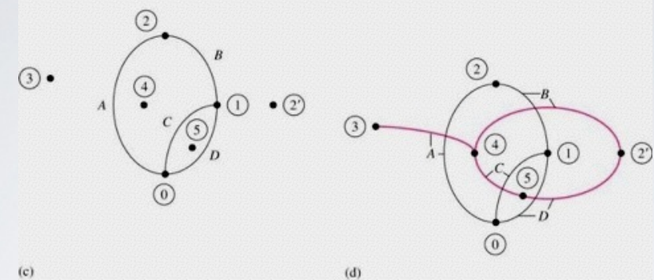
Complex Gate Design Example
Look at node numbers in the schematic Y’ = A + BC +BD
By placing nodes in the interior of each arc, plus two more outside the graph for VDD (3) and the complementary output (2’), the PMOS branch can be realized as shown on the left figure
Connect all of the nodes in the manner shown in the right figure, and the NMOS arc and that PMOS arc intersects have the same inputs.

Slide 4
COMPLEX CMOS GATE WITH BRIDGING
Design a CMOS gate that implements the following logic function using the same reference inverter sizes as the previous example:
__________________
Y = AB +CE + ADE + CDB
The NMOS branch can be realized in the following manner using bridging NMOS D to implement Y. The corresponding NMOS graph is shown in the next slide.

Slide 5
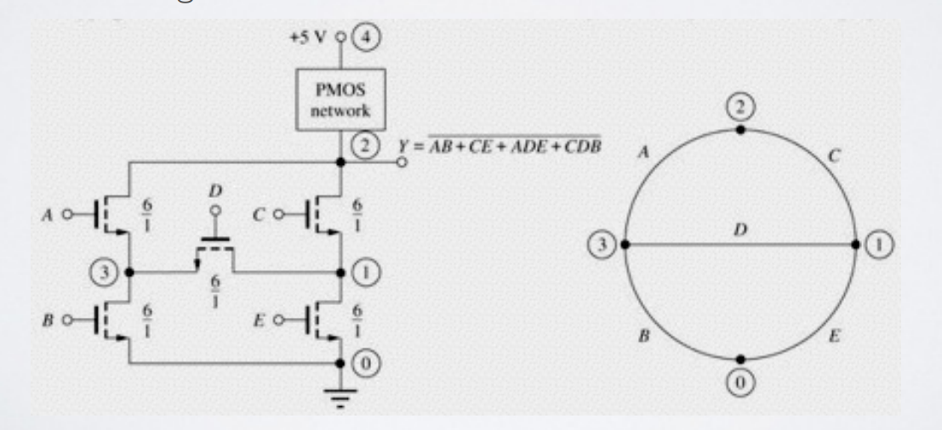
__________________ Y = AB +CE + ADE + CDB

Slide 6
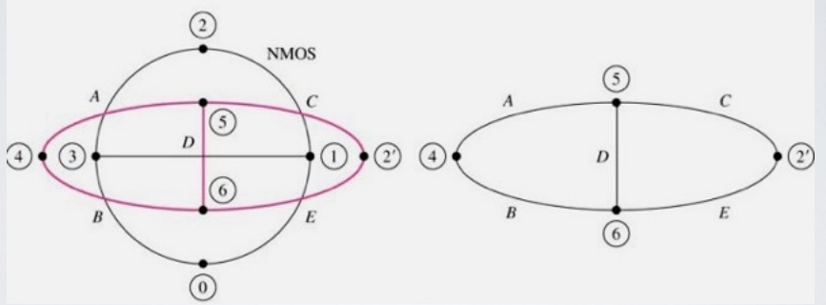
Complex CMOS Gates with Bridging

Slide 7

COMPLEX CMOS GATE WITH BRIDGING
By using the PMOS graph the PMOS branch can now be realized as the one shown on the left.
The longest path was used to select sizing

Slide 8
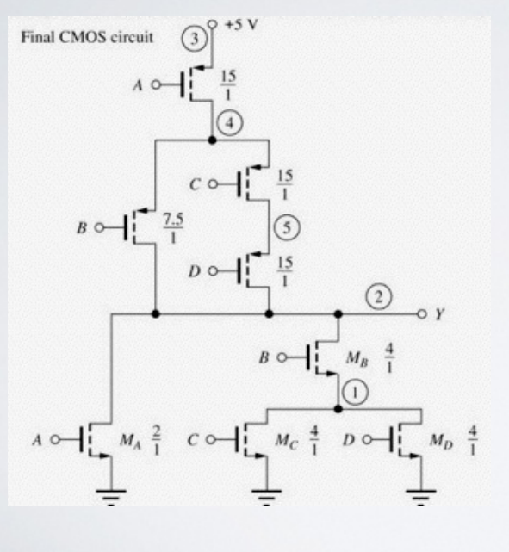
COMPLEX CMOS LOGIC GATE DESIGN EXAMPLE
From the PMOS graph, the PMOS branch can now be drawn for the final CMOS logic gate while once again considering the longest PMOS path for sizing

Slide 9
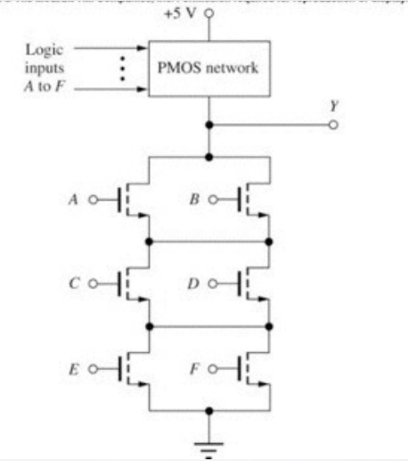
Find Pull-up Network (PUN)

Slide 10
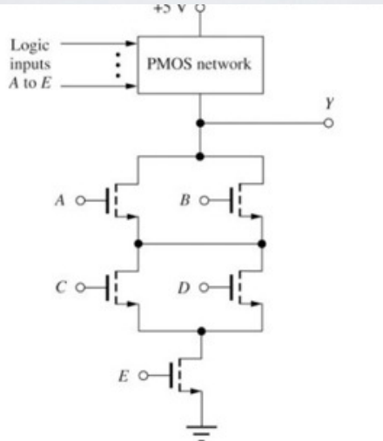
PUN?

Slide 11
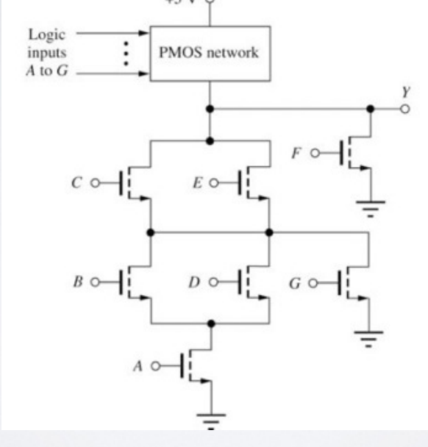
PUN?

Slide 12
Design a CMOS logic gate based on the inverter CMOS with β_{n}=β_{p} to implement the following function: Y=(ABC+DE)’
Select transistor sizes to obtain propagation times similar to those of the previous inverter

Slide 13
Design CMOS Logic Gate to implement Y=[A(B+C(D+E))]’
Select sizes to obtain same t_{p} as in the CMOS inverter

Slide 14
CMOS NOR GATE BODY EFFECT
Since the bottom PMOS body contact is not connected to its source, its threshold voltage changes as V_{SB} changes during switching
Once v_{O} = V_{H} is reached, the bottom PMOS is not affected by body effect, thus the total on-resistance of the PMOS branch is the same
However, the rise time is slowed down due to |V_{TP}| being a function of time

Slide 15
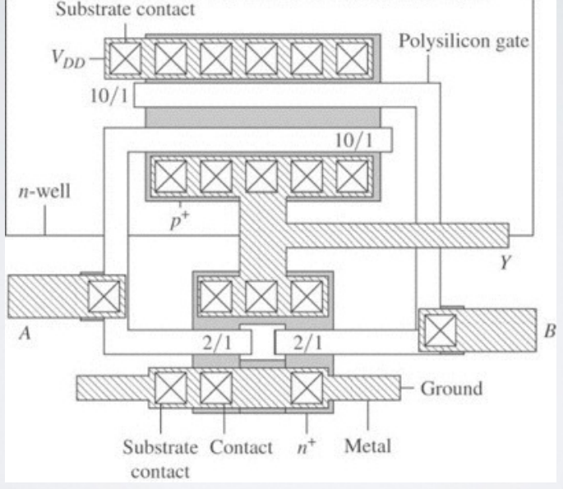
TWO-INPUT NOR GATE LAYOUT

Slide 16
MINIMUM SIZE GATE DESIGN AND PERFORMANCE
With CMOS technology, there is a area/delay trade off that needs to be considered
If minimum feature sized are used for both devices, then the τ_{PLH} will be decreased compared to the symmetrical reference inverter

Slide 17
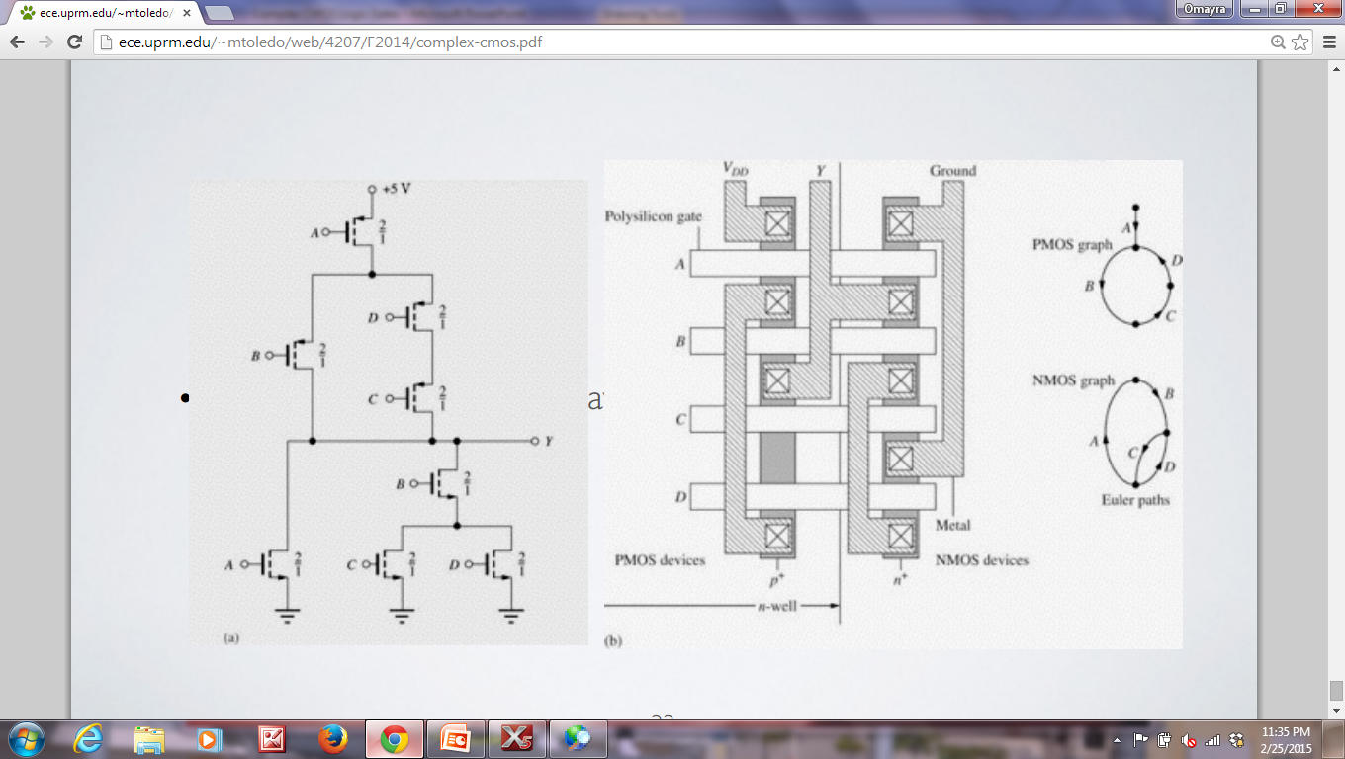
MINIMUM SIZE COMPLEX GATE AND LAYOUT

